Slide 1

Data Structures
Week 4 - Sorting Algorithms
Juan Carlos Pineda
ITESM
juancarlos.pineda@itesm.mx

Slide 2
Divide and Conquer
If we can break a single big problem into smaller sub-problems, solve the smaller sub-problems and combine their solutions to find the solution for the original big problem, it becomes easier to solve the whole problem.

Slide 3
Divide and Conquer
When Spaniards arrived to Mexico, they saw a country with different religions and regional kings, hard working but naive citizens, diversity, and found it difficult to establish their empire.
So, they adopted the policy of Divide and Rule. Where the population of Mexico was collectively a one big problem for them, they divided the problem into smaller problems, by instigating rivalries between local kings, making them stand against each other, and this worked very well for them.
Well that was history, and a socio-political policy (Divide and Rule), but the idea here is, if we can somehow divide a problem into smaller sub-problems, it becomes easier to eventually solve the whole problem.

Slide 4
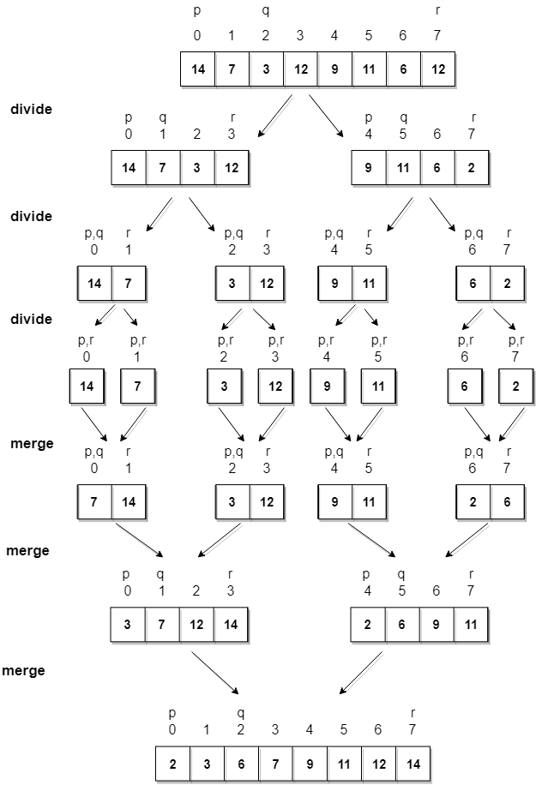
Merge Sort

Slide 5
Merge Sort Implementation
In merge sort we follow the following steps:
We take a variable p and store the starting index of our array in this. And we take another variable r and store the last index of array in it.
Then we find the middle of the array using the formula (p + r)/2 and mark the middle index as q, and break the array into two subarrays, from p to q and from q + 1 to r index.
Then we divide these 2 subarrays again, just like we divided our main array and this continues.
Once we have divided the main array into subarrays with single elements, then we start merging the subarrays.

Slide 6
Pop Quiz
Is Merge Sort a Stable Sort Algorithm?
What is the complexity of Merge Sort?

Slide 7
Characteristics of Merge Sort
As we have already learned in Binary Search that whenever we divide a number into half in every step, it can be represented using a logarithmic function, which is log n and the number of steps can be represented by log n + 1(at most)
Also, we perform a single step operation to find out the middle of any subarray, i.e. O(1).
And to merge the subarrays, made by dividing the original array of n elements, a running time of O(n) will be required.

Slide 8
Quick Sort
Sir Charles Antony Richard Hoare developed the quick sort algorithm in 1959. It is a typical divide and conquer algorithm. To sort a long array, pick an element from the array that will be the pivot element.
Then, partition the array so that the left side will contain all the elements that are smaller than the pivot and the right side will contain all the elements that are larger than, or equal to the pivot. When this is done, the left side and the right side of the array can be sorted by calling the sort recursively. To stop the recursion, when we have one single element in the array, we will declare it sorted.

Slide 9
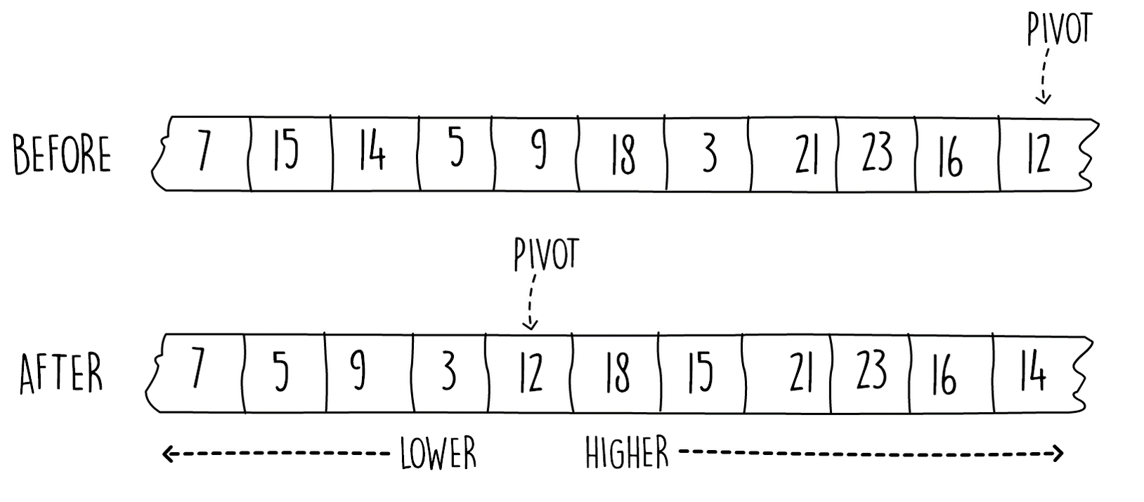
Quick Sort Partitioning

Slide 10
Quick Sort Algorithm
Pick the right most element of the array as the pivot.
Start from the left and find the next element that is larger than the pivot.
Swap this element with the next, which is smaller than pivot element.
Repeat steps 2 and 3 until no more swapping is possible.
Swap the first item which is larger than the pivot's value with the pivot itself.

